Slide 1

PROJECT STAGE-1 REVIEW (CD753PC)
Mahatma Gandhi Institute of Technology (Autonomous)
Department of Emerging Technologies | Computer Science and Engineering (Data Science)
AI-Based Smart Underground Cable Fault Detection and Remote Monitoring
Fault detection, distance estimation and predictive health monitoring using ESP32, IoT and Machine Learning
Presented by
Deta Jonah Ratan (23261A6717) • Madhavaram Vineel (24265A6702)
Pasnoori Abhinay (24265A6704)
Under the guidance of
Ms. A. Swapna
Assistant Professor, Dept. of ET
Notes:
Introduce the team, the guide and the project title. This review covers the work up to Chapter 3: introduction, literature survey and design methodology.

Slide 2
Presentation Outline
Abstract
Introduction
01
02
What the system does, in brief
Background, problem definition, existing and proposed applications
Requirements
Literature Survey
03
04
Software and hardware specifications
18 related works and the research gap
Design Methodology
Implementation Plan
05
06
Architecture, hardware, algorithm, ML pipeline, mobile app
Step-by-step build and evaluation
Notes:
Walk through the flow of the talk: abstract, the three chapters, and the design diagrams.

Slide 3
Abstract
1
Detect
Underground cable faults are hard to locate, causing long outages and costly excavation. Conventional methods such as loop tests and TDR are expensive and work only after a failure.
This project builds a low-cost ESP32 system on a current-limited cable simulator. It monitors supply-side and load-side voltage, current, and temperature (TMP117), detects open and short circuits, and estimates fault distance using Ohm's law.
Data is sent over Wi-Fi to an Android app, where a machine-learning model classifies the cable condition in the background and is compared with a baseline algorithm. Trend analysis gives a cable health index for predictive maintenance.
Open-circuit, short-circuit and abnormal conditions
2
Locate
Fault distance from calibrated measurements
3
Diagnose
ML classification in the mobile app
4
Alert
Buzzer, LEDs, OLED and app notifications
5
Predict
Health index from historical trends
Notes:
Summarise the system in one breath: sense, detect, locate, diagnose with ML on the phone, alert, and predict deterioration.

Slide 4
Introduction
01
Background • Problem Definition • Existing & Proposed Applications • Requirements
Notes:
Chapter 1 sets out why the problem matters and what we propose.

Slide 5
Background
Underground cables are widely used in cities, industries and campuses: safer, weather-protected and reliable
Being buried, a fault cannot be seen; crews often excavate long stretches to find it
Many faults start slowly as joint heating, voltage drop or irregular current
Low-cost embedded systems, IoT and ML now make continuous, intelligent monitoring possible
Open-Circuit Fault
The conductor breaks, so current stops flowing to the load. Load-side voltage and current fall to almost zero.
Short-Circuit Fault
An unintended low-resistance path forms between conductors, causing high current and a sharp voltage drop.
Notes:
Explain why underground cables are used, why faults are hard to find, and the two fault types the prototype simulates.

Slide 6
Problem Definition
1
Fault detection
2
Fault location
3
Electrical monitoring
Faults in buried cables are not detected automatically
TDR and loop tests are costly and need skilled operators
Voltage drop, overcurrent and near-zero current go unrecorded
4
Thermal stress
5
Rule-based limits
6
No history or prediction
Hot joints and loose terminations are rarely monitored
Fixed thresholds miss faults or raise false alarms
Without logged data, deterioration cannot be anticipated
Notes:
Each card is one gap in current practice that the project addresses.

Slide 7
Problem Statement and Objectives
Design a low-cost, safe and intelligent system that detects, locates and diagnoses underground cable faults, and warns of deterioration before failure.
1
Detect and classify open-circuit and short-circuit faults
2
Estimate the fault distance from calibrated measurements
3
Monitor voltage, current and temperature continuously
4
Improve diagnosis with ML over a baseline algorithm
5
Show live data and alerts in a mobile app and on the device
6
Log events and analyse trends for early warning
Notes:
State the problem in one sentence, then the six objectives that follow from it.

Slide 8
Existing Applications
Conventional Methods
Commercial Systems
Microcontroller Prototypes
How it works
How it works
How it works
Murray / Varley loop, TDR, thumper, sectionalising, acoustic tracing
Fault-location vans and online monitoring for utilities
Arduino / PIC with Ohm's-law resistor model, GSM or basic IoT
Limitation
Limitation
Limitation
Manual, offline, costly or destructive; need skilled operators
Very expensive; used mostly on HV networks after a failure
Mostly short circuits only; fixed thresholds; no current or temperature trends
Gap: no low-cost platform combines detection, distance, V/I/T monitoring, ML diagnosis, IoT, logging and predictive health.
Notes:
Existing solutions are either accurate but expensive and offline, or cheap but limited.

Slide 9
Proposed Application
1
Sense
2
Process (ESP32)
3
Diagnose (App)
Cable simulator with calibrated resistor sections and fault switches. Sensors read Vs, VL, current and TMP117 temperature.
Filtering and calibration, baseline fault detection, Ohm's-law distance estimation. Local OLED, buzzer and LED alerts.
Data sent over Wi-Fi. Background ML model gives fault type and confidence. Dashboard, alerts, event log and health index.
Low-cost ESP32
Safe low-voltage setup
ML vs baseline comparison
Mobile APK
Predictive maintenance
Notes:
Explain the three stages: sensing on the cable simulator, edge processing on the ESP32, and ML diagnosis plus monitoring in the Android app.

Slide 10
Requirements Specification
Software
Hardware
Item | Specification
OS | Windows 10/11 (64-bit) or Ubuntu 20.04+
Firmware IDE | Arduino IDE 2.x / VS Code + PlatformIO
App IDE | Android Studio
Languages | Embedded C/C++, Kotlin/Java, Python 3.8+
ML libraries | NumPy, Pandas, Scikit-learn, TensorFlow Lite
Protocol | Wi-Fi with MQTT / HTTP
Storage | SQLite (app), Firebase (optional)
Mobile OS | Android 8.0 or higher
Component | Specification
Controller | ESP32 (dual-core, built-in Wi-Fi)
Voltage sensing | Calibrated voltage dividers (Vs, VL)
Current sensing | INA219 / ACS712
Temperature | TMP117 digital sensor (I2C)
Display | 0.96"/1.3" OLED (SSD1306, I2C)
Alerts | Buzzer and status LEDs
Cable simulator | Resistor network with fault switches
Power | 5V / 12V DC, current-limited
Notes:
Software on the left, hardware on the right. GPS and GSM are excluded from this version.

Slide 11
Literature Survey
02
18 related works • IoT fault detectors, reviews and AI/ML methods • Research gap
Notes:
Chapter 2 reviews related work in three groups and identifies the gap our system fills.

Slide 12
Literature Survey (1/3)
# | Author(s) | Year | Venue | Methodology | Limitation
1 | S. K. Satyanarayana, S. N. Chandra Shekhar | 2024 | IEEE ICCCNT | Arduino, current sensing, relay, Wi-Fi cloud | Short circuits only; no ML
2 | M. Jayachandran et al. | 2024 | IEEE ICoCET | IoT detector with cloud database | ML prediction only proposed
3 | S. Jegadeesan et al. | 2026 | IEEE ICVADV | ESP32, thresholds, relays, GPS, IoT dashboard | No temperature or prediction
4 | S. Sudhagar, R. Marimuthu | 2025 | IEEE Access | Systematic review of location methods | Review only
5 | Riadul Islam et al. | 2025 | IEEE NCIM | Microcontroller, GSM and GPS localisation | No ML; no temperature
6 | INCET 2025 paper | 2025 | IEEE INCET | Fault detection and monitoring system | No health prediction
Notes:
Highlight one or two papers per slide rather than reading every row.

Slide 13
Literature Survey (2/3)
# | Author(s) | Year | Venue | Methodology | Limitation
7 | ICOCT 2025 paper | 2025 | IEEE ICOCT | Cable resistance with GPS and GSM | Rule-based only
8 | K. H. Ali et al. | 2022 | IEEE Access | LV fault-finding industry practice | No automated solution
9 | Zhou et al. | 2017 | High Voltage (IET) | Cable life-cycle management review | Review only
10 | Choudhary et al. | 2022 | Energies (MDPI) | Insulation ageing models | No real-world model
11 | A. Morales, N. Purushothaman | 2023 | Measurement | Partial discharge diagnosis review | Costly sensors
12 | J. Tao et al. | 2025 | RSER | Cable ageing monitoring review | EMI and data challenges
Notes:
Highlight one or two papers per slide rather than reading every row.

Slide 14
Literature Survey (3/3)
# | Author(s) | Year | Venue | Methodology | Limitation
13 | K. Emdadi et al. | 2025 | Sensors (MDPI) | XLPE monitoring and ML maintenance | HV cables only
14 | H. Kumar et al. | 2023 | IEEE ISGT-LA | MV cable predictive-maintenance use cases | Limited validation
15 | Q. Shao et al. | 2025 | Energies (MDPI) | AI for cable fault detection review | No hardware
16 | Said et al. | 2022 | IEEE Access | 1D-CNN + SVM classification | Simulation; heavy compute
17 | Zhao Hong-shan et al. | 2022 | IET SMT | Transfer function + autoencoder + CNN | Special measurement needed
18 | H. Livani, C. Y. Evrenosoglu | 2013 | IEEE Trans. PWRD | ML fault classification | Transmission lines only
Notes:
Highlight one or two papers per slide rather than reading every row.

Slide 15
Research Gap
1
IoT fault detectors [1-3, 5-7]
Our system fills the gap
Arduino/ESP32 with GSM, GPS or cloud. Threshold logic and resistance-based distance; little temperature monitoring and no ML in a mobile app.
Calibrated distance estimation
Real-time V, I and T monitoring
ML diagnosis vs baseline
Mobile app with alerts
Event logging
Predictive health index
Low-cost ESP32 platform
2
Reviews and practice [4, 8-14]
Stress accurate location and condition monitoring for predictive maintenance, mostly for MV/HV cables.
3
AI / ML studies [15-18]
High classification accuracy, but on simulated data or high-end systems, not on low-cost embedded hardware.
Notes:
Summarise the three groups, then show how the proposed system closes the gap.

Slide 16
Design Methodology
03
Data flow • Architecture • Hardware • Algorithm • ML pipeline • Mobile app
Notes:
Chapter 3 shows how the system is designed, one diagram per slide.

Slide 17
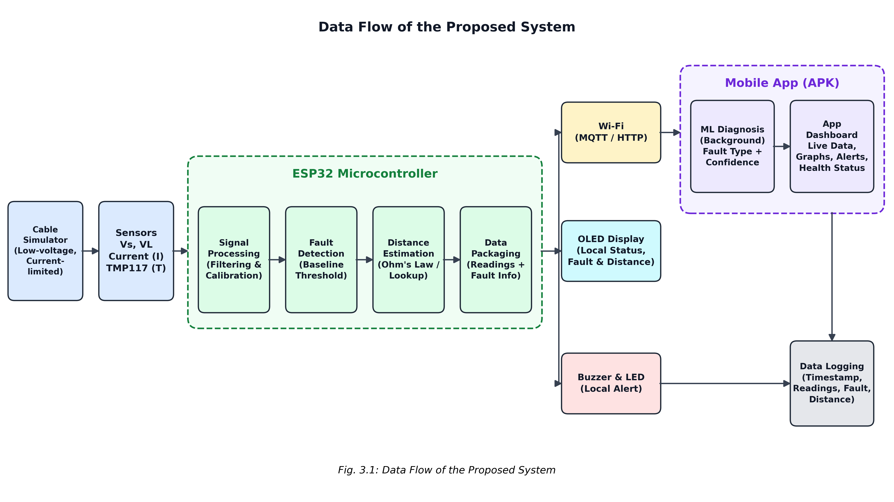
Data Flow of the Proposed System
Notes:
Sensors feed the ESP32, which processes, detects and estimates distance. Data goes over Wi-Fi to the app for ML diagnosis; OLED and buzzer give local alerts.

Slide 18
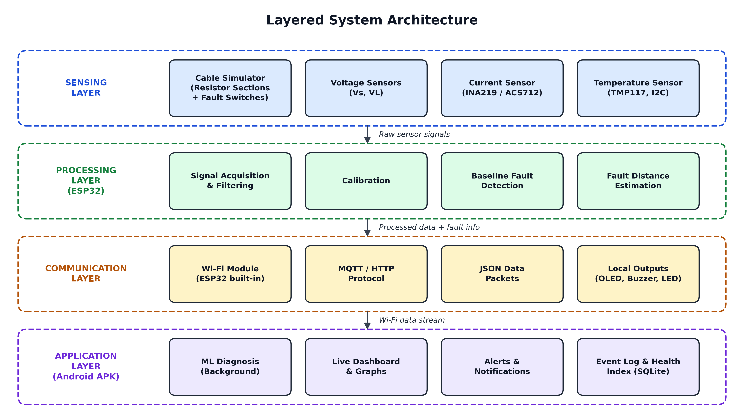
Layered System Architecture
Notes:
Four layers: sensing, processing on the ESP32, communication over Wi-Fi, and the application layer in the Android app.

Slide 19
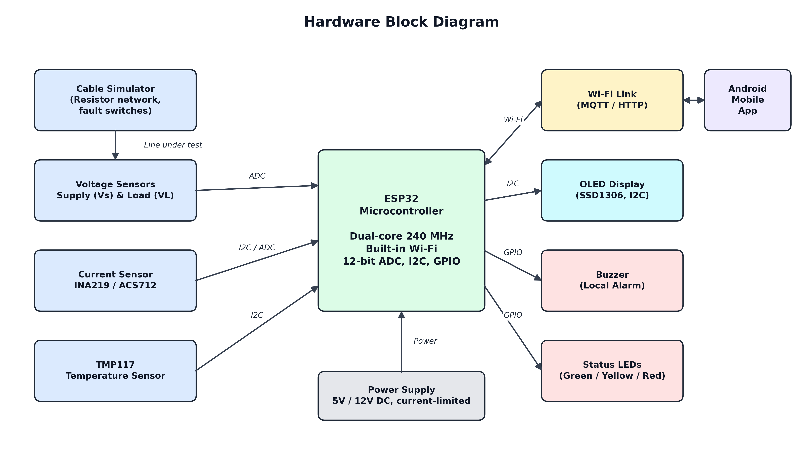
Hardware Block Diagram
Notes:
ESP32 at the centre: voltage sensors on the ADC, INA219 and TMP117 on I2C, OLED on I2C, buzzer and LEDs on GPIO, Wi-Fi to the app.

Slide 20
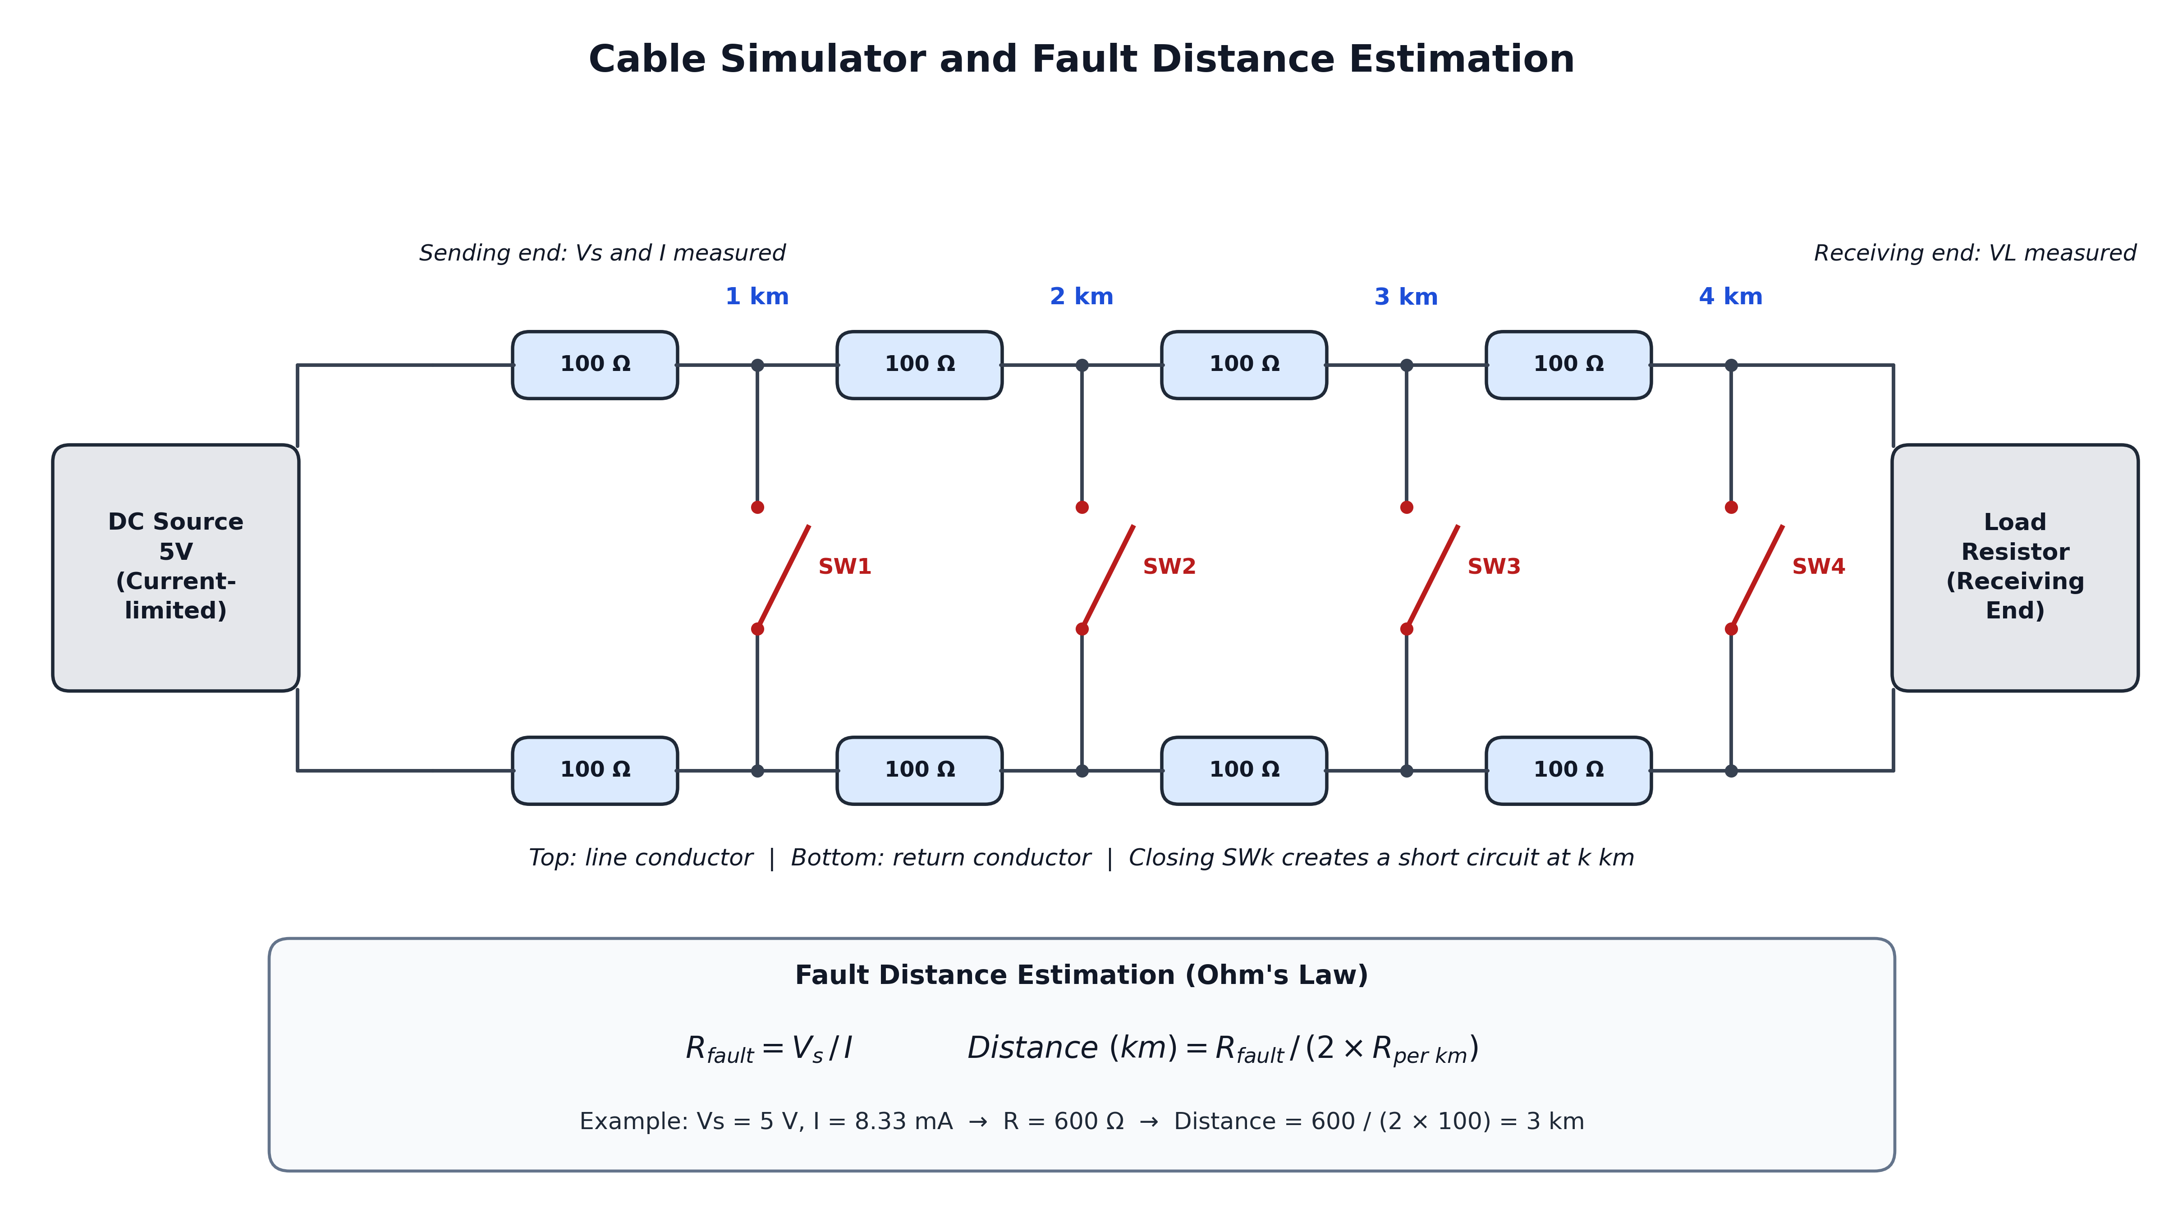
Cable Simulator and Fault Distance Estimation
Notes:
Each 1 km section is 100 ohm per conductor. Closing SWk shorts at k km. Distance = (Vs / I) / (2 x R per km). Example: 600 ohm gives 3 km.

Slide 21
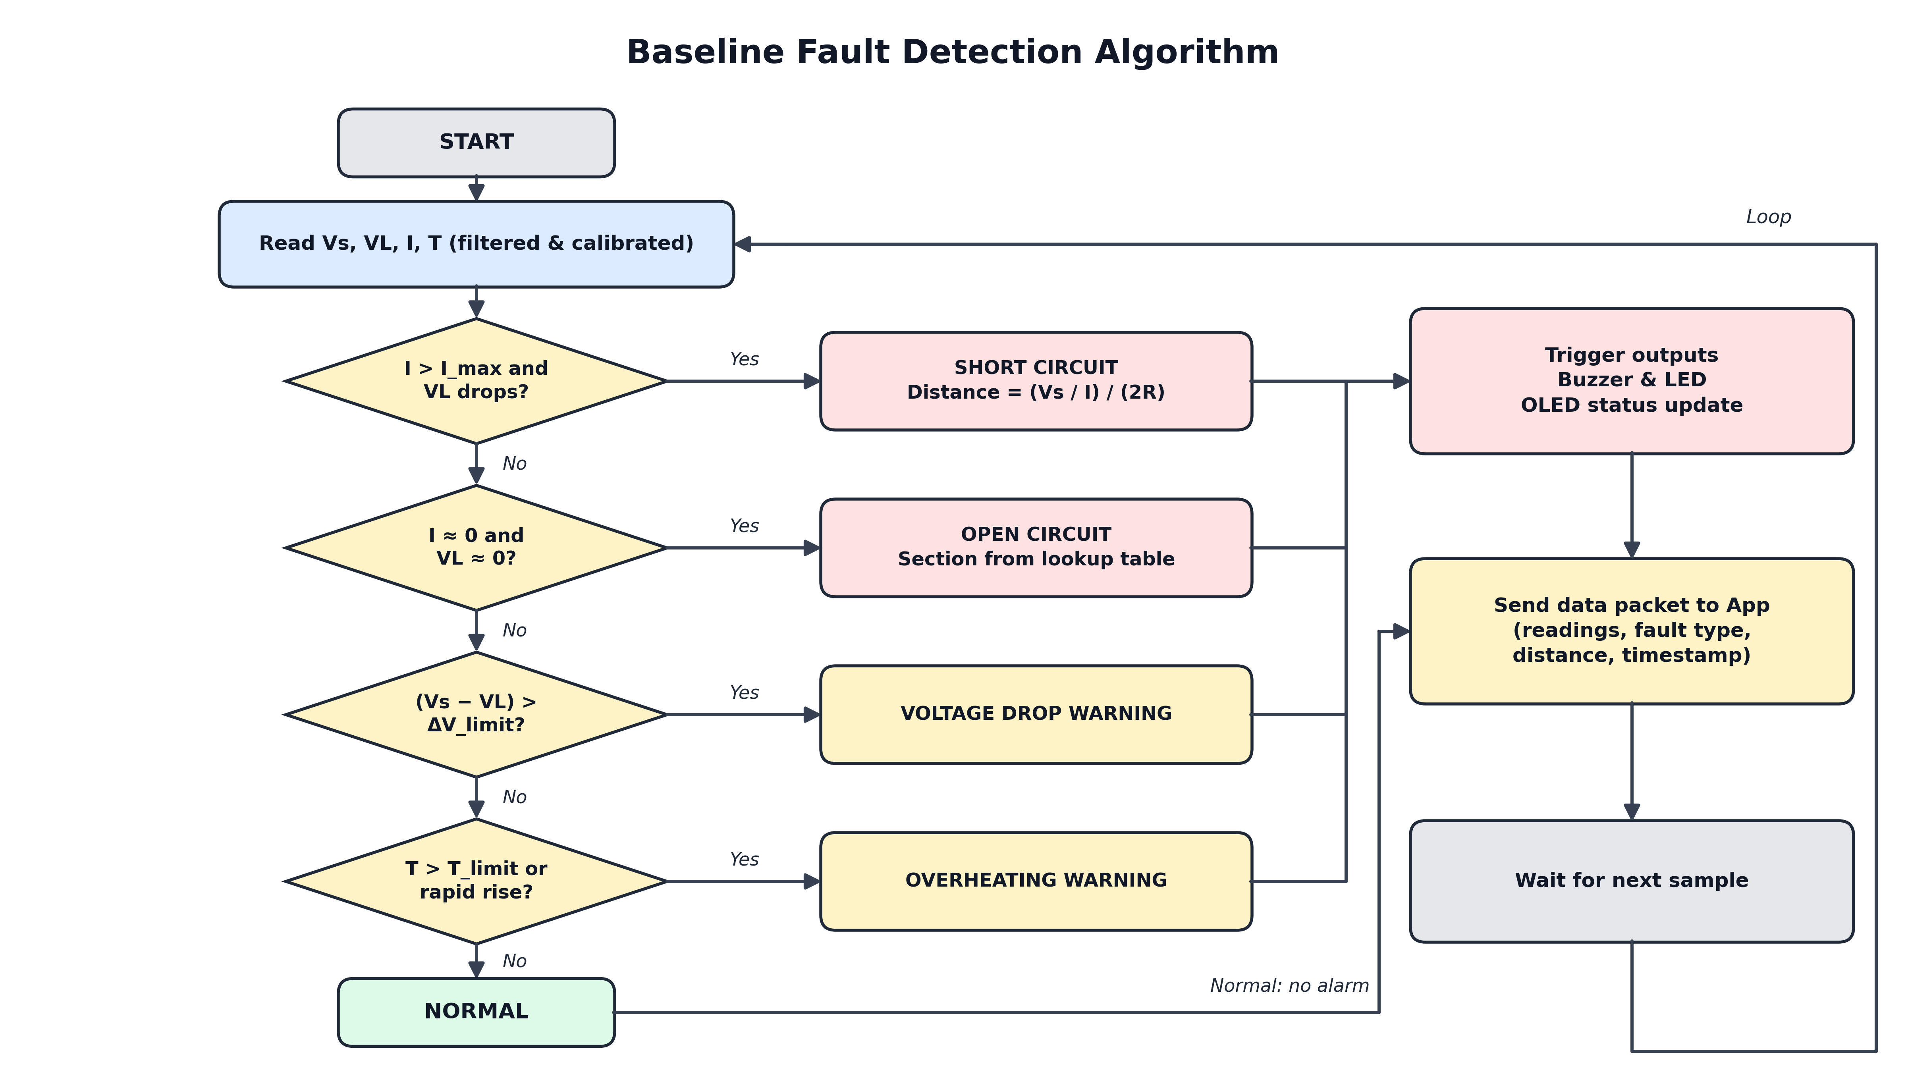
Baseline Fault Detection Algorithm
Notes:
Checks run in order: short circuit, open circuit, voltage drop, overheating. Faults trigger local alerts; every cycle sends a packet to the app.

Slide 22
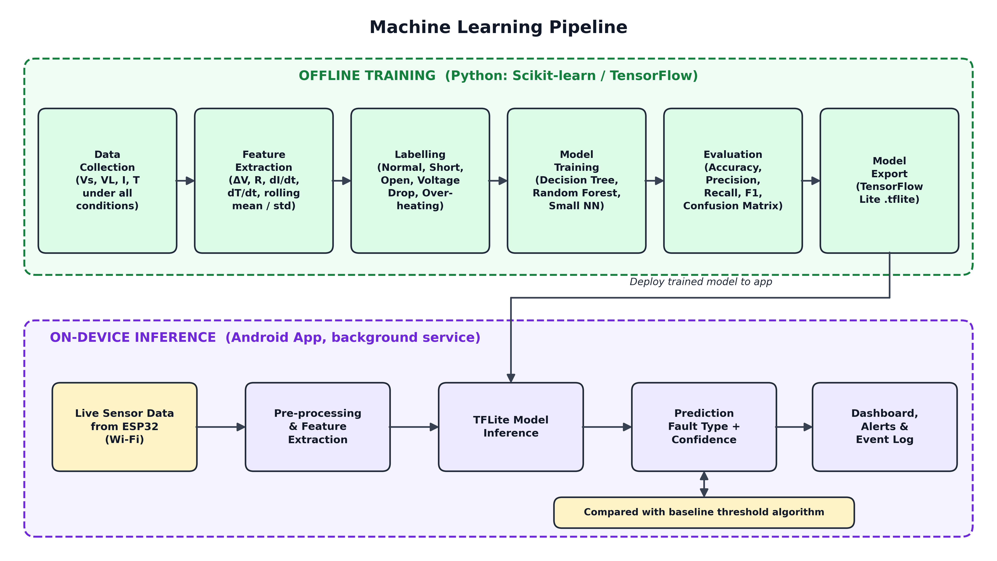
Machine Learning Pipeline
Notes:
Offline: collect, extract features, label, train, evaluate, export to TFLite. On the phone: the model runs in the background on live data and is compared with the baseline.

Slide 23
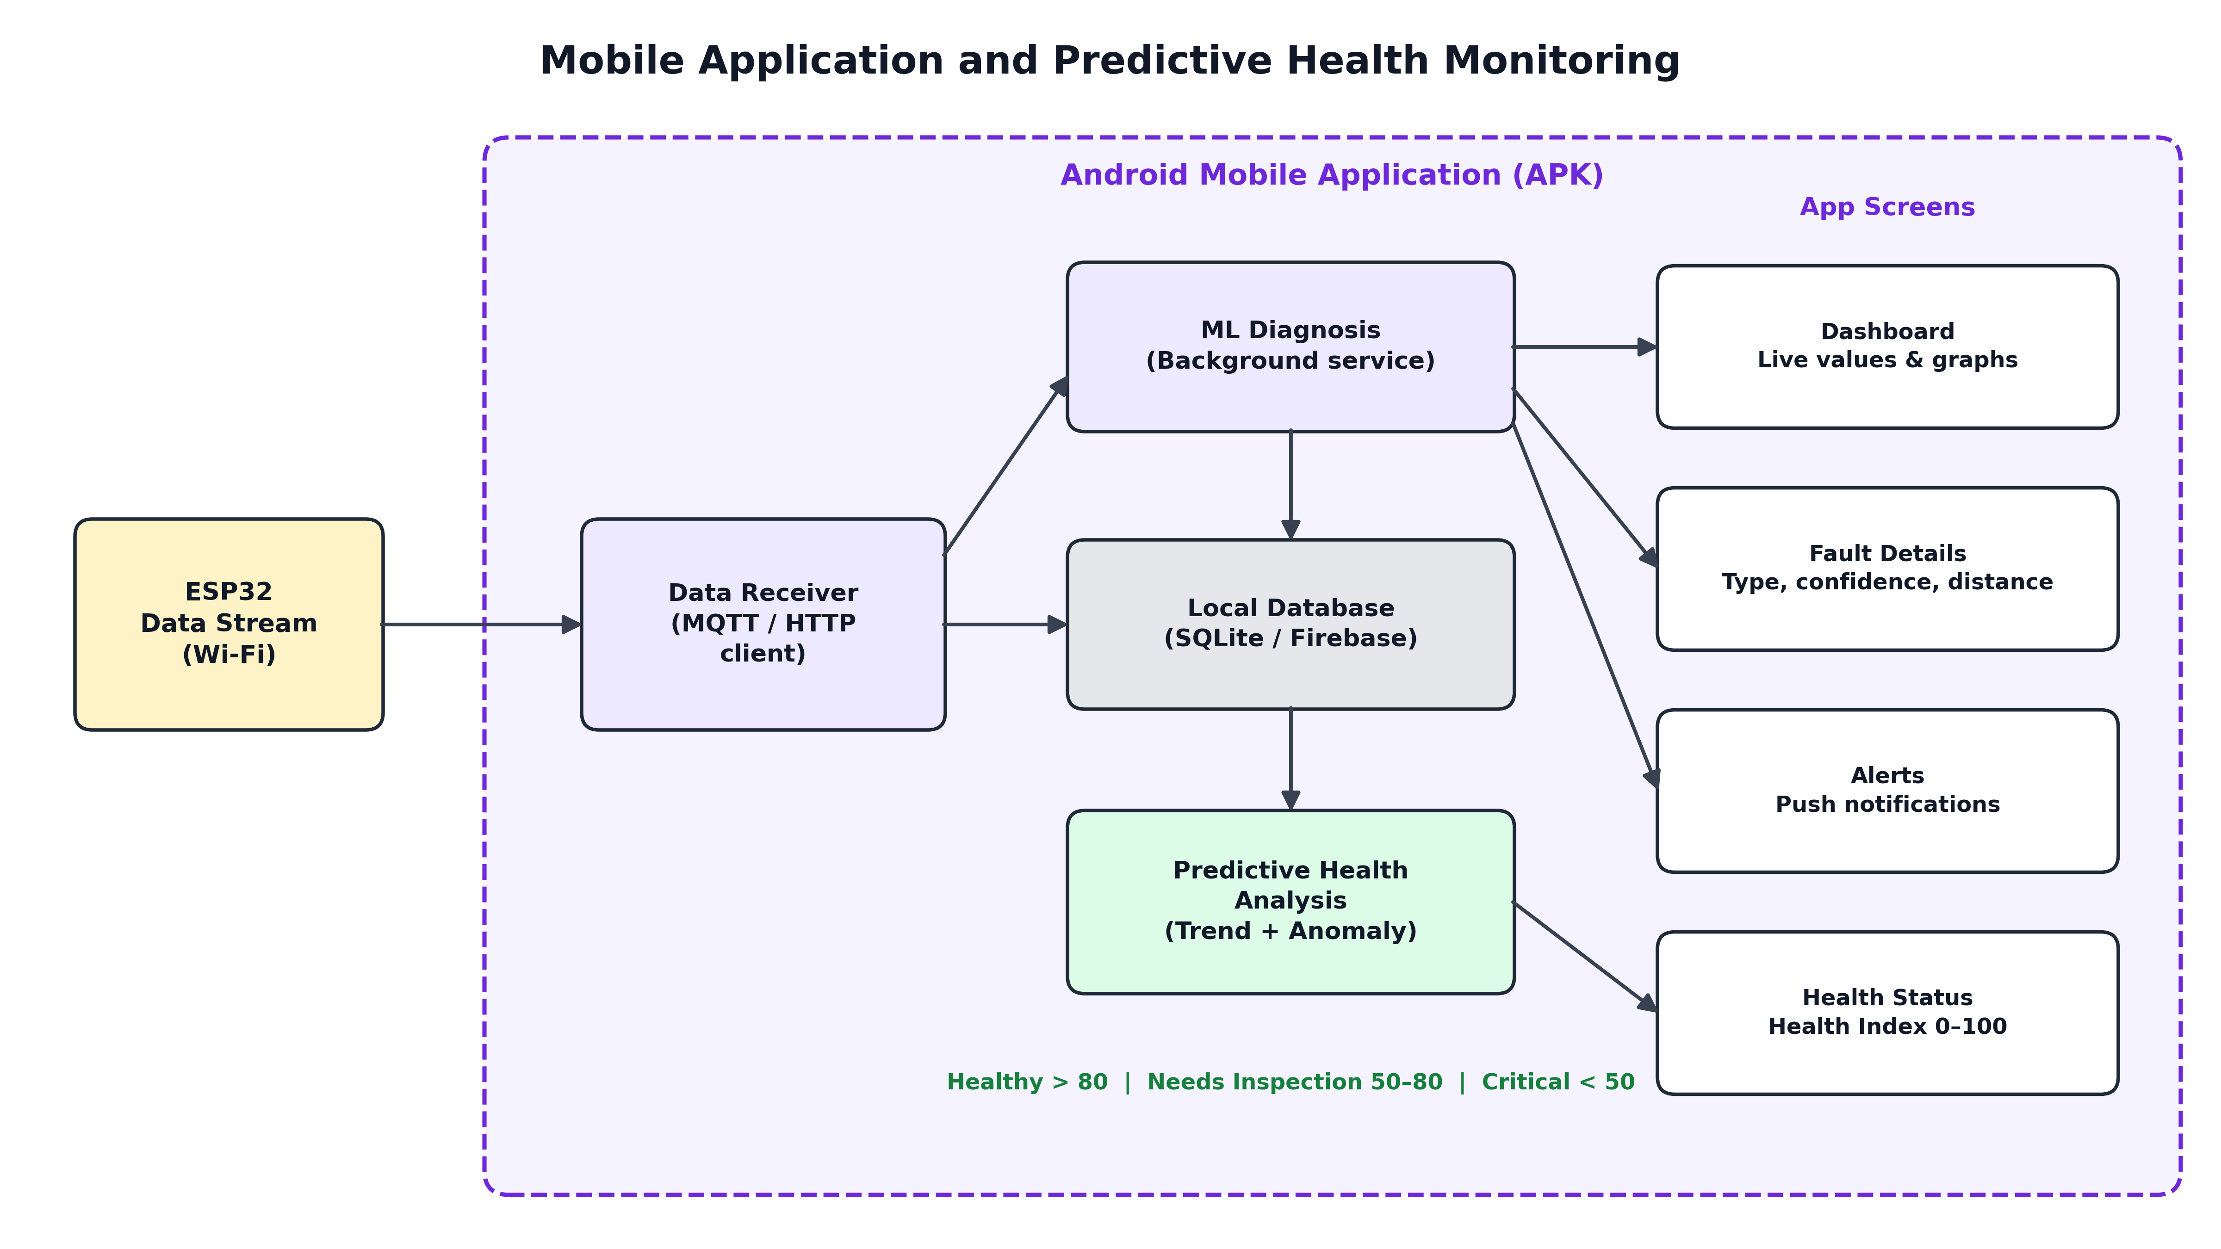
Mobile Application and Predictive Health
Notes:
The app receives data, runs ML, stores history and computes a 0-100 health index shown on four screens.

Slide 24
Implementation Plan
1
2
3
4
Assemble cable simulator and sensor circuits
ESP32 firmware: acquisition, filtering, calibration
Baseline fault detection and distance estimation
Collect and label dataset under all conditions
5
6
7
8
Train, evaluate and export the ML model
Develop the Android app and Wi-Fi link
Alerts, data logging and health analysis
Integrate, test and compare ML vs baseline
Notes:
The eight build steps, in order. Steps 1-3 are hardware and firmware, 4-5 ML, 6-8 app, alerts and integration.

Slide 25
Thank You
Questions and suggestions are welcome
Deta Jonah Ratan • Madhavaram Vineel • Pasnoori Abhinay
Guide: Ms. A. Swapna, Assistant Professor, Dept. of ET, MGIT
Notes:
Thank the panel and invite questions.

